Slide 1
Megan Witherow
Mary Aman
Matt Schroeder
Charles Chiou
PROJECT TITLE: MeetU@ODU
TEAM NAME: CMMM Labs

Slide 2
ODU Hackathon 2016 Objective
Use technology to encourage people to meet in real life
Community Concern: ODU Community

Slide 3
Methodology
Eliminate instant-messaging interactions.
What sort of occasions/events do college students engage in?
Identify popular spots on ODU Campus.

Slide 4
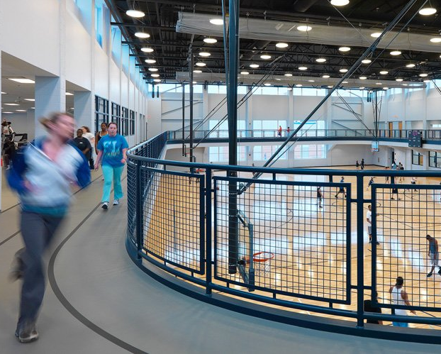
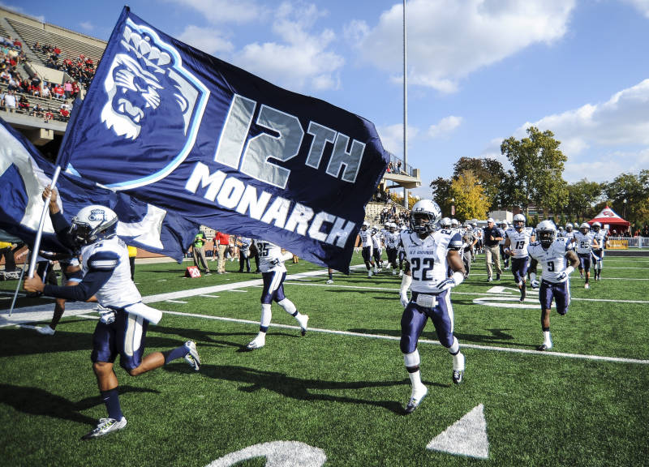
Sports
Students and alumni show their pride by attending ODU sporting events.
Intramurals provide students a fun way to exercise and interact with others.

Slide 5
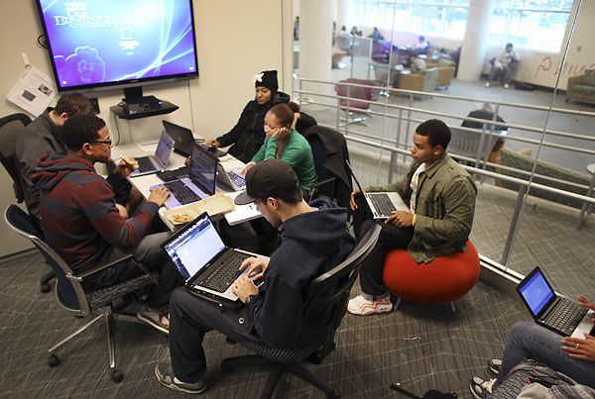
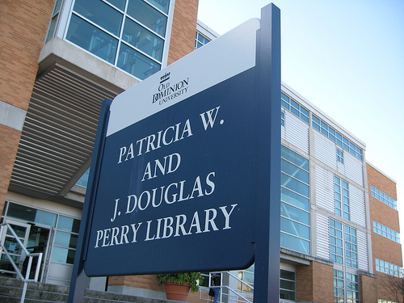
Studying
Students have to balance an academic workload at ODU that forces them to collaborate and study with classmates.

Slide 6
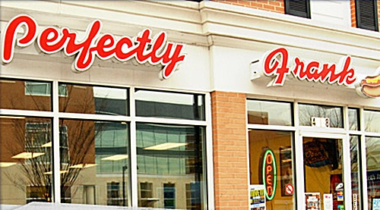






Food
Freshman 15 exists for a reason! An easy way for students to meet up is to study or hangout in the dining halls, and there are tons of good restaurants close to ODU’s campus.

Slide 7
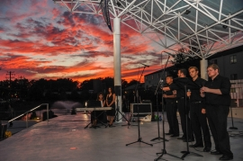


Arts/Entertainment
ODU has a large presence in the arts and diverse community culture. Check out the Planetarium, catch a movie at MGB, or concerts/art galleries are all options available for students at ODU.

Slide 8
Application Features
Pre-determined activities and locations
Designated meeting points via campus map
Invite student(s) for various social occasions
Students can accept/decline events

Slide 9
Future Work
Integrate with ODU MIDAS system for login credentials
Additional occasions/events/locations
(Orchid Conservatory, Brock Commons/Arts District, Gordon Arts Gallery, Volunteering, etc.)
Implement hashtag filtering
(Soccer, Basketball, Student orgs, etc.)
Suggest activities/people
Special event alerts
(Ted Concerts, Homecoming, Hackathon, etc.)

Slide 10
Questions?

